Slide 1
Gamification of Data
Group 1: Zaid Alsafi, Cam Kozan, Alex Navarre

Slide 2
Project Scope
The goal of our project was to create a gamified web application for Invisi-Tag. Invisi-Tag is a company that uses RFID tags and scanners to help companies keep track of their equipment. The main task was to help their workers gain motivation and be rewarded for properly doing their job.
The finished product was for a user to go into the the web application and see how they rank against their peers, track and view their achievements, and see how all of the the teams are doing within the company

Slide 3
Project Scope
The gamification web application uses the client’s API that allows us to see all of each companies team assets. Each asset, or tool, contains a cost and weight that has been incorporated into the website and helps determine an individual and teams score.
We chose to use badges, challenges, levels, and experience points in our implementation of gamification to help give the users a sense of progress and rewards. Completed challenges give badges and experience, which helps the user increase their level and receive rewards.

Slide 4
What We’ve Done
Successfully integrate the front and back end from previous group
Created a services to:
Pull data from the Invisi-Tag API
Generate scores
Track and complete challenges
Give rewards and experience
Created a database in Microsoft Azure
Set up AWS account for Sargon Partners
Migrated database to RDS
Set up EC2 instance to run software remotely

Slide 5
What We’ve Done (cont)
Create a system that gives users badges and exp for completing challenges
Allow a user to reset their password
Allow an admin to create challenges and give user challenges
Add new teams
Add new employees
Add new assets (tools)
Update current assets
Update current teams
Update employees

Slide 6
Things Left To Do
Transfer ownership of Github repository to Sargon Partners
Provide set up and use document for included software
Update EC2 instance
Receive final signature

Slide 7
Things That Went Well
Communication with the client has been going well. They typically respond same day which makes it extremely useful if we have any questions about the requirements or how some technology works.
Client was helpful with coming up with ideas and helping us out when we needed it.
Learning new languages and technologies went surprisingly well.

Slide 8
Things That Didn’t Go Well
One of our members dropped the group so we had to pick up more work.
The end of the semester came a lot faster than we had anticipated.
One of our clients tried to add requirements near the end of the term.

Slide 9
Lessons Learned
Things typically take longer than expected
If you’re uncertain about something, ask sooner rather than later
Things typically don’t go as planned the first time around

Slide 10
Knowledge and skills
We’ve used a lot of our knowledge and skills from past classes on this project. Some of them include:
CIS 421 to help us with making the database schema and queries
CIS 435 helping us understand how the Web works
CIS 375 allowing us to understand how to work in teams on a large scale project

Slide 11
Project Description
Design a website that incorporates the concept of gamification that can help companies motivate and reward their employees for their good behaviors.
Invisi-tag is an asset management system which uses RFID tags to help businesses effortlessly keep track of their inventory.
Our job is to take the data from the Invisi-Tag system and provide companies with a platform that allows them to encourage employee engagement
Gamified Concepts:
Scores
Badges
Levels
Challenges

Slide 12
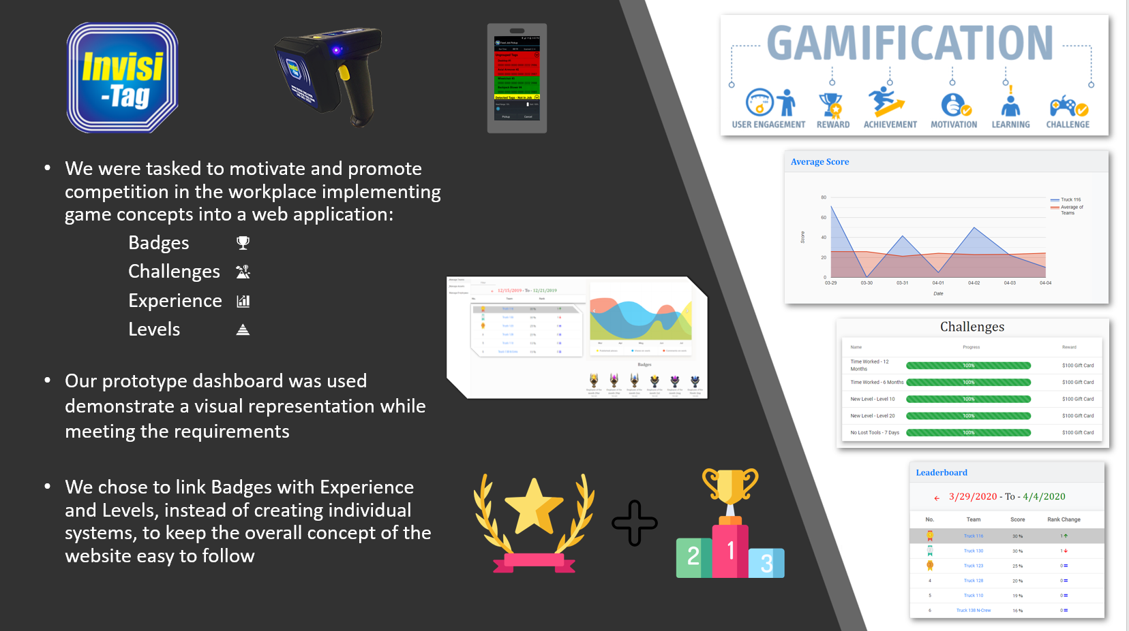
Project Poster

Slide 13
Elevator Pitch
We created a gamified web application to help motivate and reward employees. A user receives badges and experience by completing challenges to raise their level and unlock customizable rewards. Employees are given a dashboard that displays a leaderboard so they can track their individual and team scores, along with being able to view their peer’s score and information. We believe that his helps promote motivation and competition within the workplace and gives employers a way to reward their employees.

Slide 14
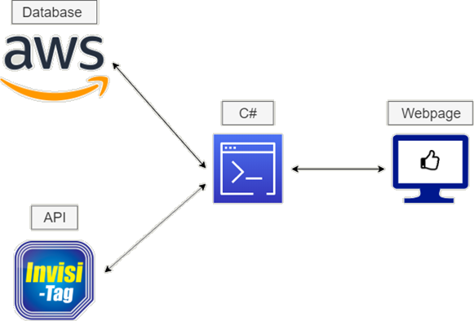
Project Overview

Slide 15
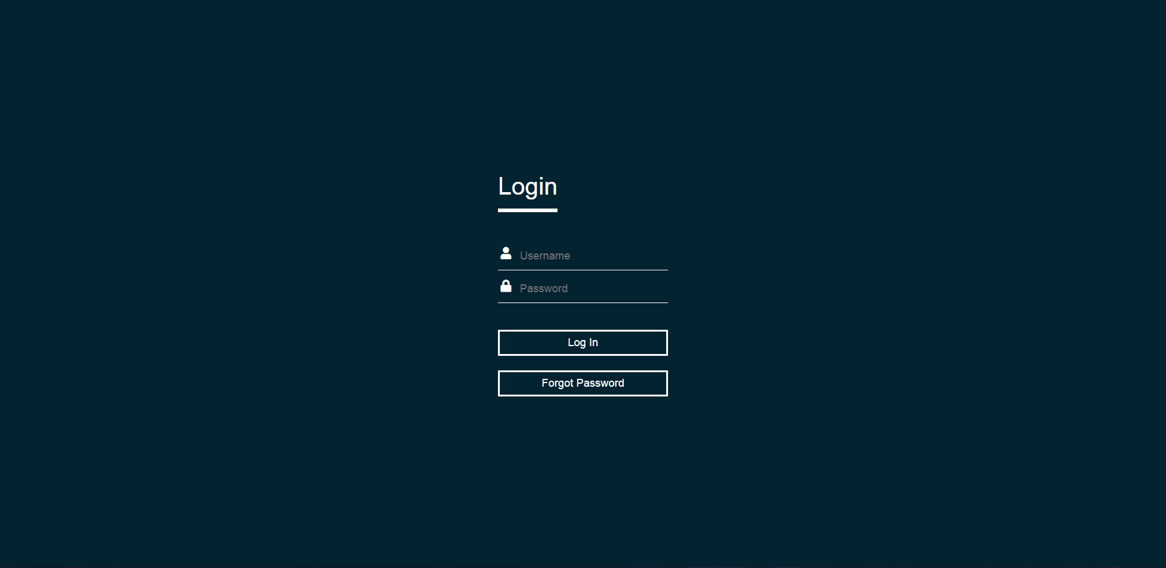
Login Screen

Slide 16
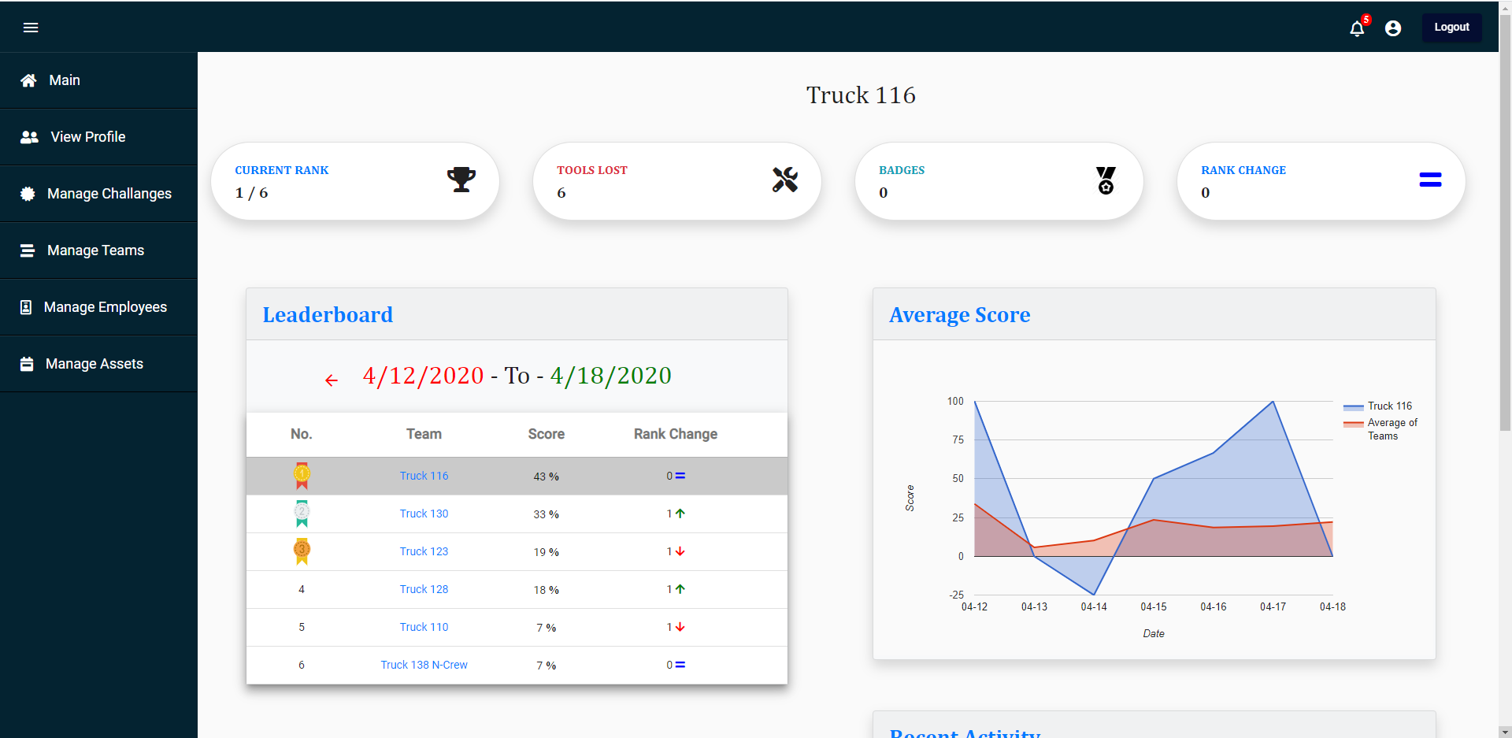
Admin Dashboard

Slide 17
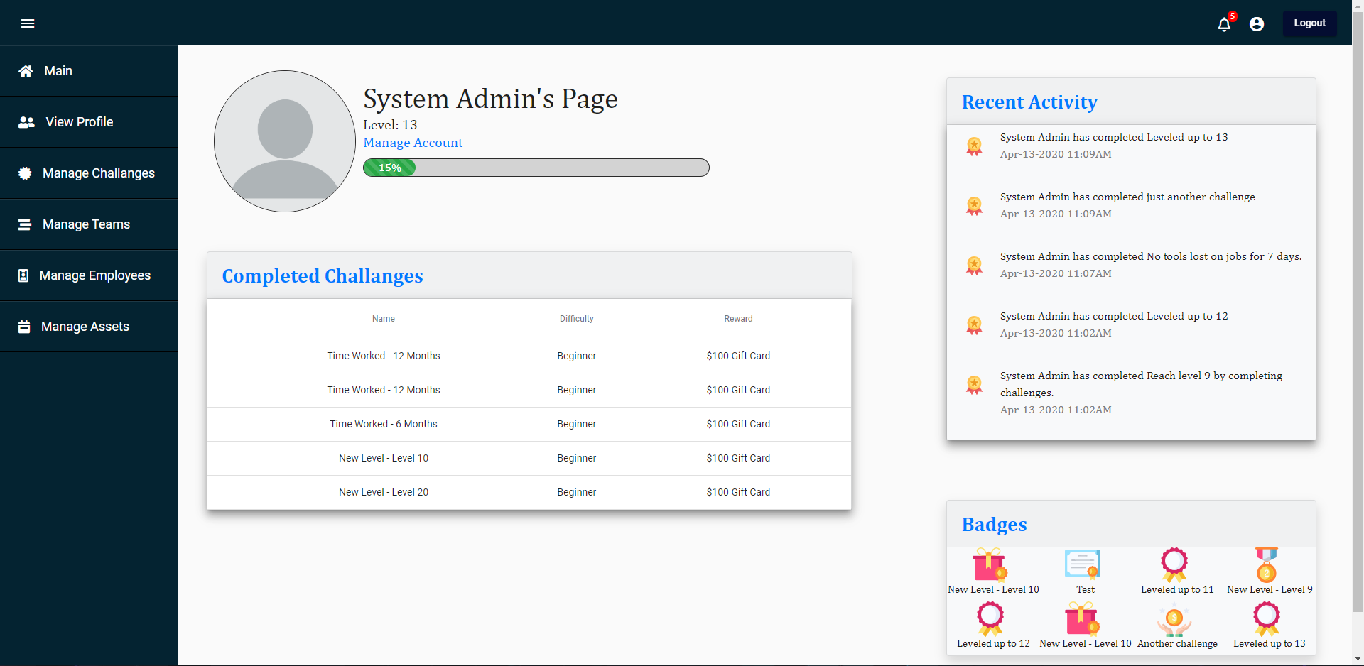
Profile Page

Slide 18
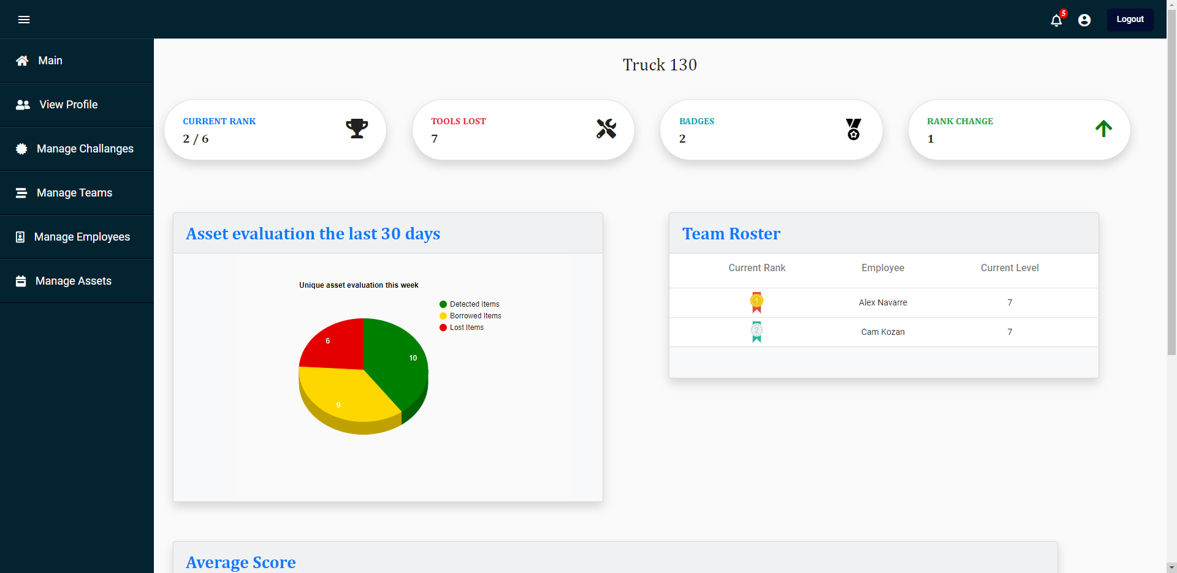
Truck Dashboard

Slide 19

Demo

